Slide 1
Relational Algebra
CS 236
Fall 2023

Slide 2
Overview
Topics
Cartesian product
Relations
Select, project, rename – and precedence
Due
Homework 14 due Wednesday
Homework 15 due Friday
Project 3 due Thursday, Nov 9
historically one of the more easy projects
be sure to see TA video or notes about __eq__ and __hash__

Slide 3
Set Review

Slide 4
Set Concepts
Set builder notation
Union
Intersection
Subset
Empty set and universal set
Set difference
Set complement
Set cardinality
Power set
Cartesian product

Slide 5


Tuples
An n-tuple is an ordered collection of n elements
2-tuple
n-tuple
You’ve used 2-tuples to
specify x,y-coordinates
(1, 5) ≠ (5, 1)
. (1, 5)
. (5, 1)
x
0
y

Slide 6
Tuples
An n-tuple is an ordered collection of n elements
2-tuple
n-tuple
You’ve used 2-tuples to
specify x,y-coordinates
(1, 5) ≠ (5, 1)
Think “quadruplets” or “quintuplets”
. (1, 5)
. (5, 1)
x
0
y

Slide 7
Tuples
An n-tuple is an ordered collection of n elements
2-tuple
n-tuple
You’ve used 2-tuples to
specify x,y-coordinates
(1, 5) ≠ (5, 1)
. (1, 5)
. (5, 1)
x
0
Order matters in tuples
y

Slide 8



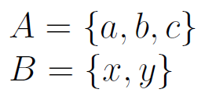
Cartesian Product
Cartesian product: creates a set with all possible n-tuples from n sets
What is given the following?

Slide 9
Cartesian Product
Cartesian product: creates a set with all possible n-tuples from n sets
What is given the following?

Slide 10
Cartesian Product
Cartesian product: creates a set with all possible n-tuples from n sets
What is given the following?

Slide 11
Relations

Slide 12
Cartesian Product
A = set of all BYU football players
A x A x A … x A --- 11 times represents all possible combinations of players on offense at the same time
(a,b,c,… j,k) is an 11-tuple belonging to A x A x A … x A
This is one specific set of players
The order matters
(QB,HB,FB, x,y,z,LT,LG,C,RG,RT)

Slide 13
Cartesian Product
A = set of all BYU football players
A x A x A … x A --- 11 times represents all possible combinations of players on offense at the same time
The order matters
(QB,HB,FB, x,y,z,LT,LG,C,RG,RT)
OFFENSE LINEUPS is a subset of A x A x A … x A
A set of tuples, not all combinations of players, just those that fill their positions
Relations are subsets of Cartesian Products
Relations are sets of tuples

Slide 14


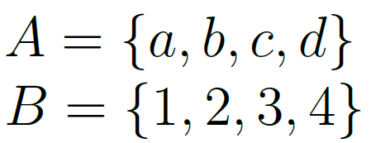
What is a Relation?
A relation is a subset of the Cartesian product of sets
Thus a relation is a set of tuples

Slide 15
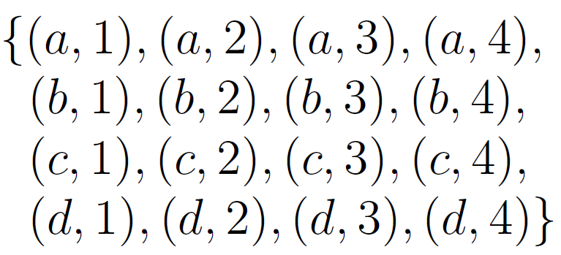
What is a Relation?
A relation is a subset of the Cartesian product of sets
Thus a relation is a set of tuples

Slide 16
What is a Relation?
A relation is a subset of the Cartesian product of sets
Thus a relation is a set of tuples
here’s one subset

Slide 17
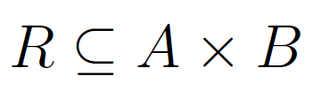
What is a Relation?
A relation is a subset of the Cartesian product of sets
Thus a relation is a set of tuples

Slide 18
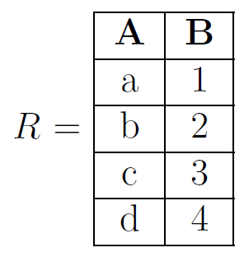
Relations as Tables
We’re not using the textbook for this portion of the course because we want to teach the operators in the context of databases

Slide 19
Relations as Tables
We’re not using the textbook for this portion of the course because we want to teach the operators in the context of databases
We’ll explicitly list attributes (column labels) to help us keep track of what each element of the tuple represents

Slide 20
Relations as Tables
Schemes:
student(N, I, A, M)
WhoMajor(N, M)
Facts:
student('Roosevelt', '32', 'New York', 'History’).
student('Reagan', '40', 'California', 'Economics’).
student('G.W.Bush','42','Texas', 'History’).
student('Clinton','43','Arkansas', 'Politics').
Rules:
WhoMajor(N,M):-student(N,I,A,M).
Queries:
WhoMajor('Roosevelt',N)?
WhoMajor(M,'Econ’)?
student(N, I, A, 'History’)

Slide 21
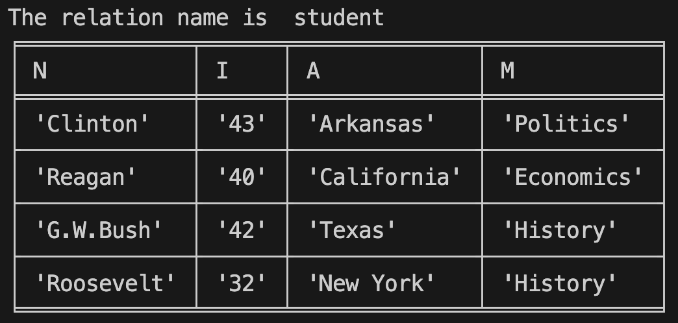
Relations as Tables
Schemes:
student(N, I, A, M)
WhoMajor(N, M)
Facts:
student('Roosevelt', '32', 'New York', 'History’).
student('Reagan', '40', 'California', 'Economics’).
student('G.W.Bush','42','Texas', 'History’).
student('Clinton','43','Arkansas', 'Politics').
Rules:
WhoMajor(N,M):-student(N,I,A,M).
Queries:
WhoMajor('Roosevelt',N)?
WhoMajor(M,'Econ’)?
student(N, I, A, 'History’)

Slide 22
Relations as Tables
Schemes:
student(N, I, A, M)
WhoMajor(N, M)
Facts:
student('Roosevelt', '32', 'New York', 'History’).
student('Reagan', '40', 'California', 'Economics’).
student('G.W.Bush','42','Texas', 'History’).
student('Clinton','43','Arkansas', 'Politics').
Rules:
WhoMajor(N,M):-student(N,I,A,M).
Queries:
WhoMajor('Roosevelt',N)?
WhoMajor(M,'Econ’)?
student(N, I, A, 'History’)
Attributes:
Name
Identifier
Address
Major

Slide 23
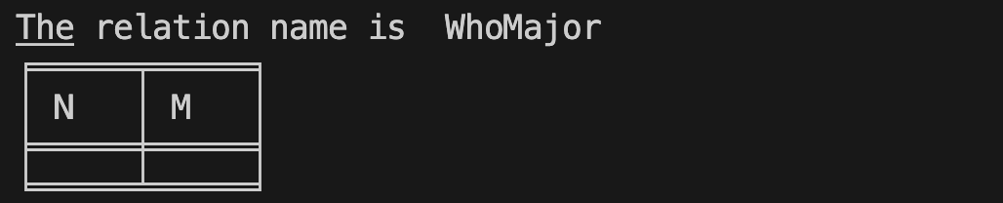
Relations as Tables
Schemes:
student(N, I, A, M)
WhoMajor(N, M)
Facts:
student('Roosevelt', '32', 'New York', 'History’).
student('Reagan', '40', 'California', 'Economics’).
student('G.W.Bush','42','Texas', 'History’).
student('Clinton','43','Arkansas', 'Politics').
Rules:
WhoMajor(N,M):-student(N,I,A,M).
Queries:
WhoMajor('Roosevelt',N)?
WhoMajor(M,'Econ’)?
student(N, I, A, 'History’)

Slide 24
Relations as Tables
Schemes:
student(N, I, A, M)
WhoMajor(N, M)
Facts:
student('Roosevelt', '32', 'New York', 'History’).
student('Reagan', '40', 'California', 'Economics’).
student('G.W.Bush','42','Texas', 'History’).
student('Clinton','43','Arkansas', 'Politics').
Rules:
WhoMajor(N,M):-student(N,I,A,M).
Queries:
WhoMajor('Roosevelt',N)?
WhoMajor(M,'Econ’)?
student(N, I, A, 'History’)
Attributes:
Name
Major

Slide 25
Relations as Tables
Schemes:
student(N, I, A, M)
WhoMajor(N, M)
Facts:
student('Roosevelt', '32', 'New York', 'History’).
student('Reagan', '40', 'California', 'Economics’).
student('G.W.Bush','42','Texas', 'History’).
student('Clinton','43','Arkansas', 'Politics').
Rules:
WhoMajor(N,M):-student(N,I,A,M).
Queries:
WhoMajor('Roosevelt',N)?
WhoMajor(M,'Econ’)?
student(N, I, A, 'History’)
Tuple

Slide 26
Relations as Tables
The student relation with all tuples
Schemes:
student(N, I, A, M)
WhoMajor(N, M)
Facts:
student('Roosevelt', '32', 'New York', 'History’).
student('Reagan', '40', 'California', 'Economics’).
student('G.W.Bush','42','Texas', 'History’).
student('Clinton','43','Arkansas', 'Politics').
Rules:
WhoMajor(N,M):-student(N,I,A,M).
Queries:
WhoMajor('Roosevelt',N)?
WhoMajor(M,'Econ’)?
student(N, I, A, 'History’)

Slide 27
Relations as Tables
Schemes:
student(N, I, A, M)
WhoMajor(N, M)
Facts:
student('Roosevelt', '32', 'New York', 'History’).
student('Reagan', '40', 'California', 'Economics’).
student('G.W.Bush','42','Texas', 'History’).
student('Clinton','43','Arkansas', 'Politics').
Rules:
WhoMajor(N,M):-student(N,I,A,M).
Queries:
WhoMajor('Roosevelt',N)?
WhoMajor(M,'Econ’)?
student(N, I, A, 'History’)
The WhoMajor relation with all tuples

Slide 28
Relations as Tables
Schemes:
student(N, I, A, M)
WhoMajor(N, M)
Facts:
student('Roosevelt', '32', 'New York', 'History’).
student('Reagan', '40', 'California', 'Economics’).
student('G.W.Bush','42','Texas', 'History’).
student('Clinton','43','Arkansas', 'Politics').
Rules:
WhoMajor(N,M):-student(N,I,A,M).
Queries:
WhoMajor('Roosevelt',N)?
WhoMajor(M,'Econ’)?
student(N, I, A, 'History’)
The WhoMajor relation with all tuples
Are empty relations ok?

Slide 29
Relations as Tables
Schemes:
student(N, I, A, M)
WhoMajor(N, M)
Facts:
student('Roosevelt', '32', 'New York', 'History’).
student('Reagan', '40', 'California', 'Economics’).
student('G.W.Bush','42','Texas', 'History’).
student('Clinton','43','Arkansas', 'Politics').
Rules:
WhoMajor(N,M):-student(N,I,A,M).
Queries:
WhoMajor('Roosevelt',N)?
WhoMajor(M,'Econ')?
The WhoMajor relation with all tuples
Are empty relations ok?

Slide 30
Relational Algebra

Slide 31
Regular Algebra
In “regular” algebra, you have operands
x, y, 1, 2, 3 …
In “regular” algebra, you have operators
+, -, *, /, ^

Slide 32
Relational Algebra
In “regular” algebra, you have operands
x, y, 1, 2, 3 …
In “regular” algebra, you have operators
+, -, *, /, ^
In relational algebra, you have operands
R1, R2, … relations
In relational algebra, you have operators
union, set difference, select, project, rename …

Slide 33
Relational Operations
Since relations are sets of tuples, the operators include set operators
Union, intersection, difference, and cross-product (Cartesian product) just like with sets
Discuss these when we meet next

Slide 34
Select

Slide 35

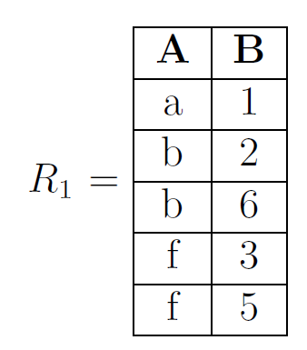
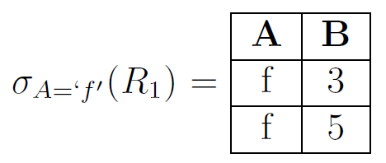
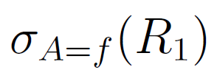
Select
Greek lowercase-letter sigma,
Think of select as operation to “choose rows”
Creates a new relation

Slide 36
Select
Greek lowercase-letter sigma,
Think of select as operation to “choose rows”
Creates a new relation
Unary operator:
Take R₁ and create a new relation

Slide 37
Select
Greek lowercase-letter sigma,
Think of select as operation to “choose rows”
Creates a new relation
The entire subscript is the condition used to select the rows

Slide 38
Select
Greek lowercase-letter sigma,
Think of select as operation to “choose rows”
Creates a new relation
Attribute A

Slide 39
Select
Greek lowercase-letter sigma,
Think of select as operation to “choose rows”
Creates a new relation
Attribute A equals f

Slide 40
Select
Greek lowercase-letter sigma,
Think of select as operation to “choose rows”
Creates a new relation
Unary operator:
Take R₁ and create a new relation

Slide 41

Select
Greek lowercase-letter sigma,
Think of select as operation to “choose rows”
Creates a new relation

Slide 42
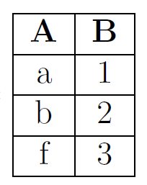
Select
Greek lowercase-letter sigma,
Think of select as operation to “choose rows”
Creates a new relation

Slide 43
Select has two forms
Attribute has value
Value of attribute A matches value of attribute B

Slide 44
Select
Greek lowercase-letter sigma,
Think of select as operation to “choose rows”
Creates a new relation
value of attribute A matches
value of attribute B
Notes:
R_5 =
\begin{array}{|c|c|} \hline
A & B \\\hline
1 & 1 \\\hline
1 & 2 \\\hline
2 & 3 \\\hline
4 & 4 \\\hline
4 & 3 \\\hline
\end{array}

Slide 45
Select
Greek lowercase-letter sigma,
Think of select as operation to “choose rows”
Creates a new relation
Notes:
R_5 =
\begin{array}{|c|c|} \hline
A & B \\\hline
1 & 1 \\\hline
1 & 2 \\\hline
2 & 3 \\\hline
4 & 4 \\\hline
4 & 3 \\\hline
\end{array}

Slide 46
Relations as Tables
Schemes:
student(N, I, A, M)
WhoMajor(N, M)
Facts:
student('Roosevelt', '32', 'New York', 'History’).
student('Reagan', '40', 'California', 'Economics’).
student('G.W.Bush','42','Texas', 'History’).
student('Clinton','43','Arkansas', 'Politics').
Rules:
WhoMajor(N,M):-student(N,I,A,M).
Queries:
WhoMajor('Roosevelt',N)?
WhoMajor(M,'Econ’)?
student(N, I, A, 'History’)

Slide 47
Relations as Tables
Schemes:
student(N, I, A, M)
WhoMajor(N, M)
Facts:
student('Roosevelt', '32', 'New York', 'History’).
student('Reagan', '40', 'California', 'Economics’).
student('G.W.Bush','42','Texas', 'History’).
student('Clinton','43','Arkansas', 'Politics').
Rules:
WhoMajor(N,M):-student(N,I,A,M).
Queries:
WhoMajor('Roosevelt',N)?
WhoMajor(M,'Econ’)?
student(N, I, A, 'History’)

Slide 48
Relations as Tables
Schemes:
student(N, I, A, M)
WhoMajor(N, M)
Facts:
student('Roosevelt', '32', 'New York', 'History’).
student('Reagan', '40', 'California', 'Economics’).
student('G.W.Bush','42','Texas', 'History’).
student('Clinton','43','Arkansas', 'Politics').
Rules:
WhoMajor(N,M):-student(N,I,A,M).
Queries:
WhoMajor('Roosevelt',N)?
WhoMajor(M,'Econ’)?
student(N, I, A, 'History’)

Slide 49
Relations as Tables
Schemes:
student(N, I, A, M)
WhoMajor(N, M)
Facts:
student('Roosevelt', '32', 'New York', 'History’).
student('Reagan', '40', 'California', 'Economics’).
student('G.W.Bush','42','Texas', 'History’).
student('Clinton','43','Arkansas', 'Politics').
Rules:
WhoMajor(N,M):-student(N,I,A,M).
Queries:
WhoMajor('Roosevelt',N)?
WhoMajor(M,'Econ’)?
student(N, I, A, 'History’)

Slide 50
Project

Slide 51

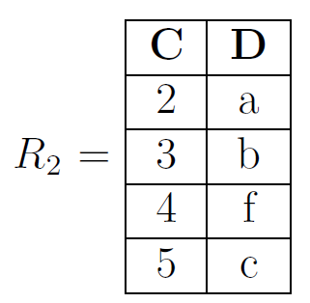
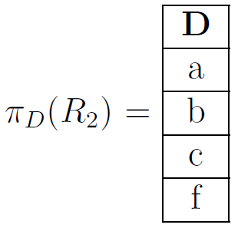
Project
Greek lowercase-letter pi,
Think of project as operation to “choose columns”
Creates a new relation

Slide 52
Project
Greek lowercase-letter pi,
Think of project as operation to “choose columns”
Creates a new relation
Unary operator:
Take R₂ and create a new relation

Slide 53
Project
Greek lowercase-letter pi,
Think of project as operation to “choose columns”
Creates a new relation
The subscript tells me which columns to choose

Slide 54
Project
Greek lowercase-letter pi,
Think of project as operation to “choose columns”
Creates a new relation

Slide 55

Project
Greek lowercase-letter pi,
Think of project as operation to “choose columns”
Creates a new relation

Slide 56
Project
Greek lowercase-letter pi,
Think of project as operation to “choose columns”
Creates a new relation
Trick question: project can also be used to switch columns around

Slide 57
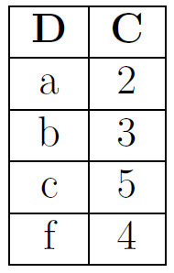
Project
Greek lowercase-letter pi,
Think of project as operation to “choose columns”
Creates a new relation

Slide 58
Rename

Slide 59

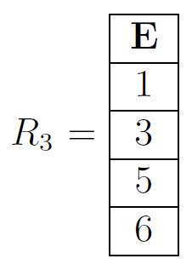
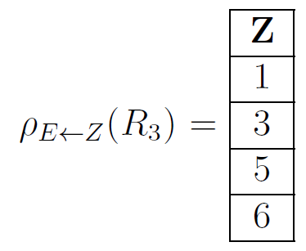
Rename
Greek lowercase-letter rho,
Think of rename as operation to “change attributes”
Creates a new relation
Unary operator:
Take R₃ and create a new relation

Slide 60
Rename
Greek lowercase-letter rho,
Think of rename as operation to “change attributes”
Creates a new relation
The subscript tells me which attribute gets changed

Slide 61
Rename
Greek lowercase-letter rho,
Think of rename as operation to “change attributes”
Creates a new relation
I like to think of E ← Z as saying “Write Z over E”
The subscript tells me which attribute gets changed

Slide 62
Rename
I like to think of E ← Z as saying “Write Z over E”
Greek lowercase-letter rho,
Think of rename as operation to “change attributes”
Creates a new relation

Slide 63

Rename
Greek lowercase-letter rho,
Think of rename as operation to “change attributes”
Creates a new relation

Slide 64
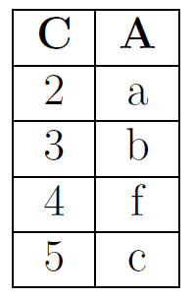
Rename
Greek lowercase-letter rho,
Think of rename as operation to “change attributes”
Creates a new relation

Slide 65
Match
Select
Project
Rename
Switch column order
Choose rows
Change attribute names
Choose columns

Slide 66
Match
Select
Project
Rename
Switch column order
Choose rows
Change attribute names
Choose columns

Slide 67
Precedence

Slide 68
Precedence
Select, Project, and Rename have equal precedence (highest in Relational Algebra). They are evaluated from right to left

Slide 69
Right to left
You’ve seen this before

Slide 70

Right to left
You’ve seen this before

Slide 71

Precedence
Select, Project, and Rename have equal precedence (highest in Relational Algebra). They are evaluated from right to left
Using parentheses can help

Slide 72

Precedence
Select, Project, and Rename have equal precedence (highest in Relational Algebra). They are evaluated from right to left
Using parentheses can help

